Slide 1
HUMAN RESOURCE ANALYSIS:
Leveraging Data for Better Decisions
By
Nimisha Jyothi

Slide 2
OBJECTIVE:
To create an HR analytics dashboard that provides insights into employee demographics, turnover rates, hiring trends, performance metrics, and satisfaction scores to improve HR decision-making
DATA SOURCE: Human Resource Analysis Dataset
TOOLS USED: Tableau, SQL

Slide 3
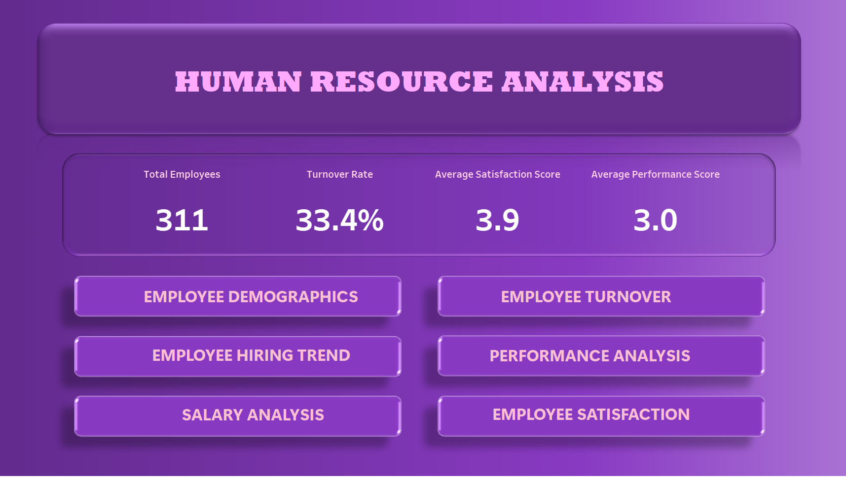

Slide 4
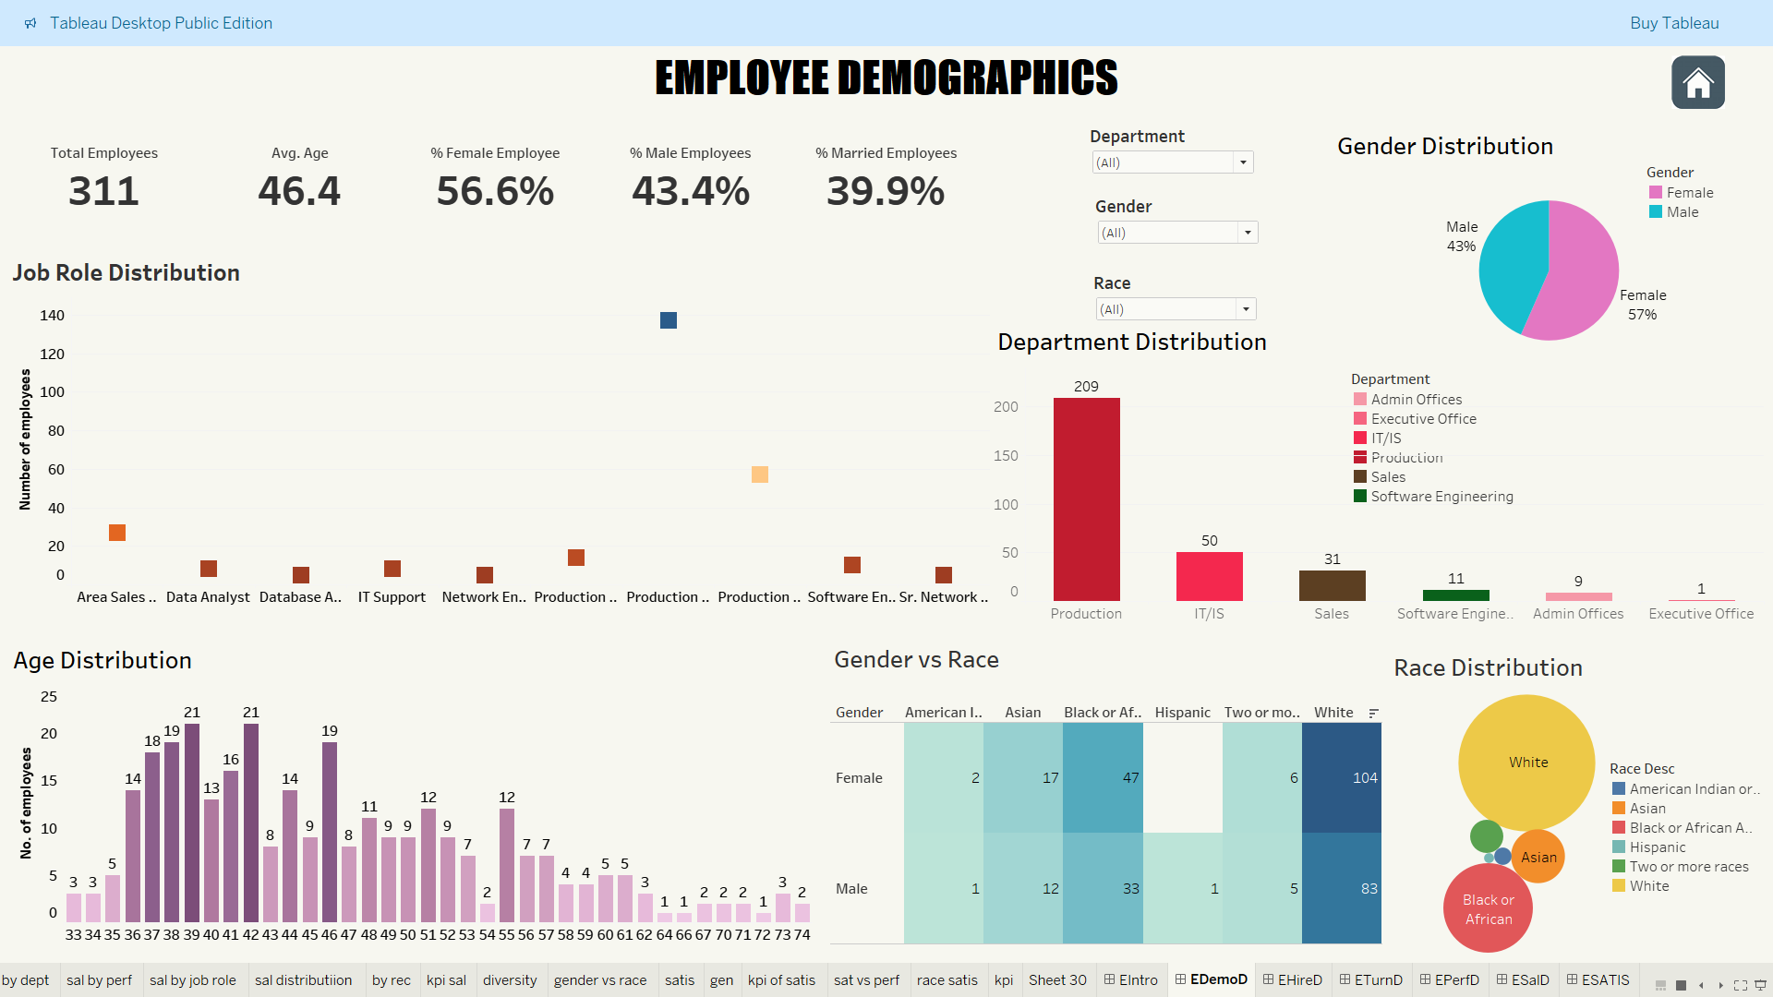

Slide 5
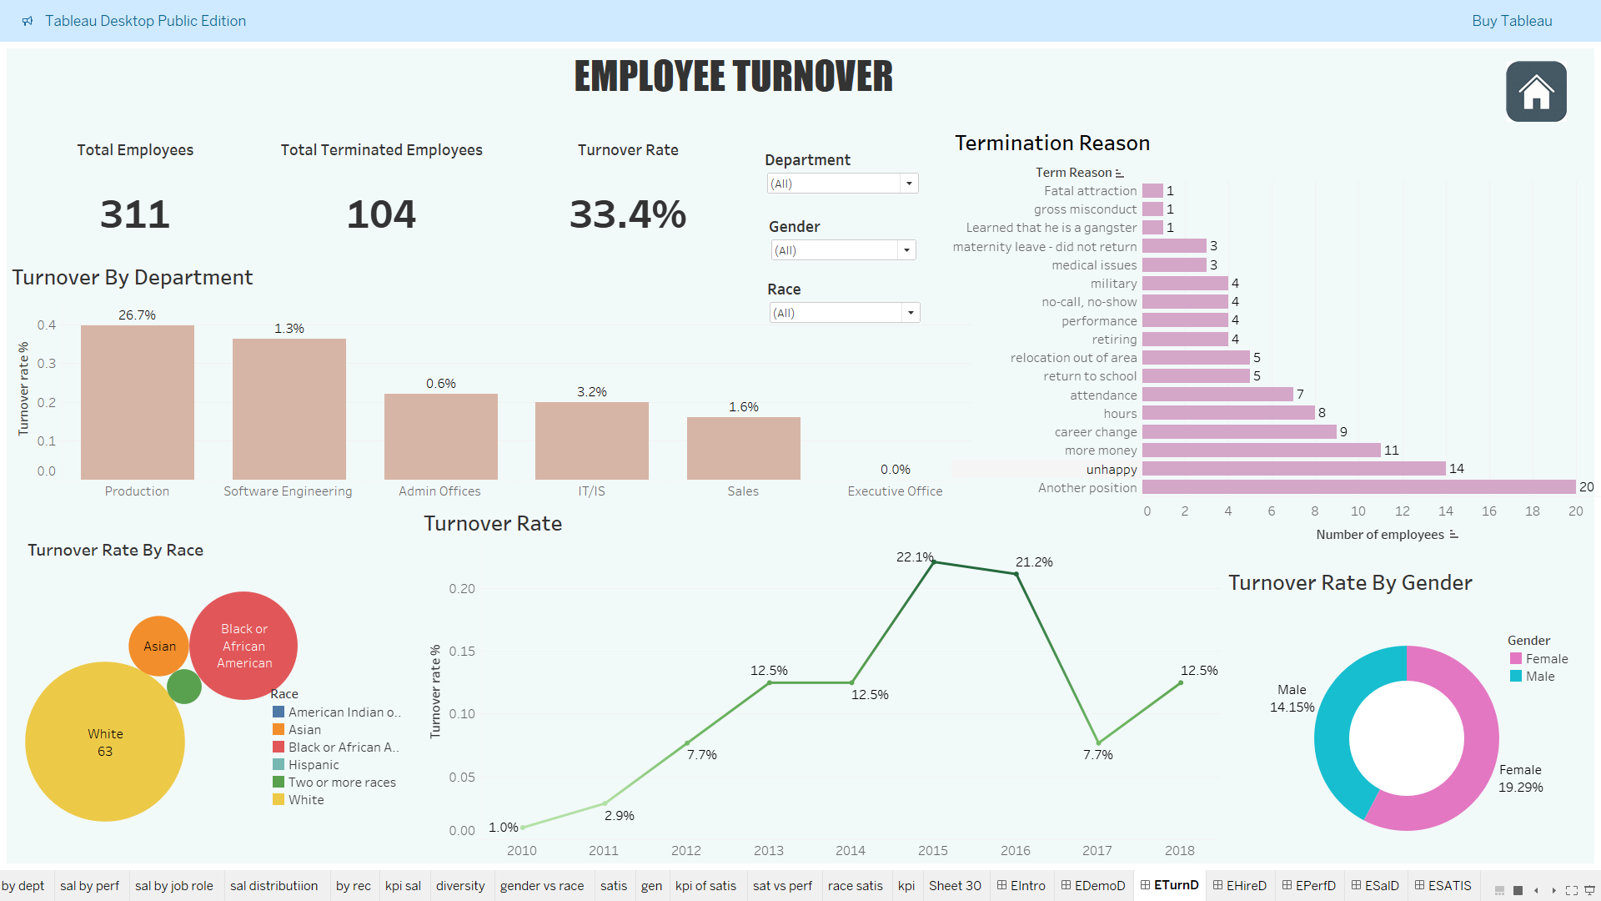

Slide 6
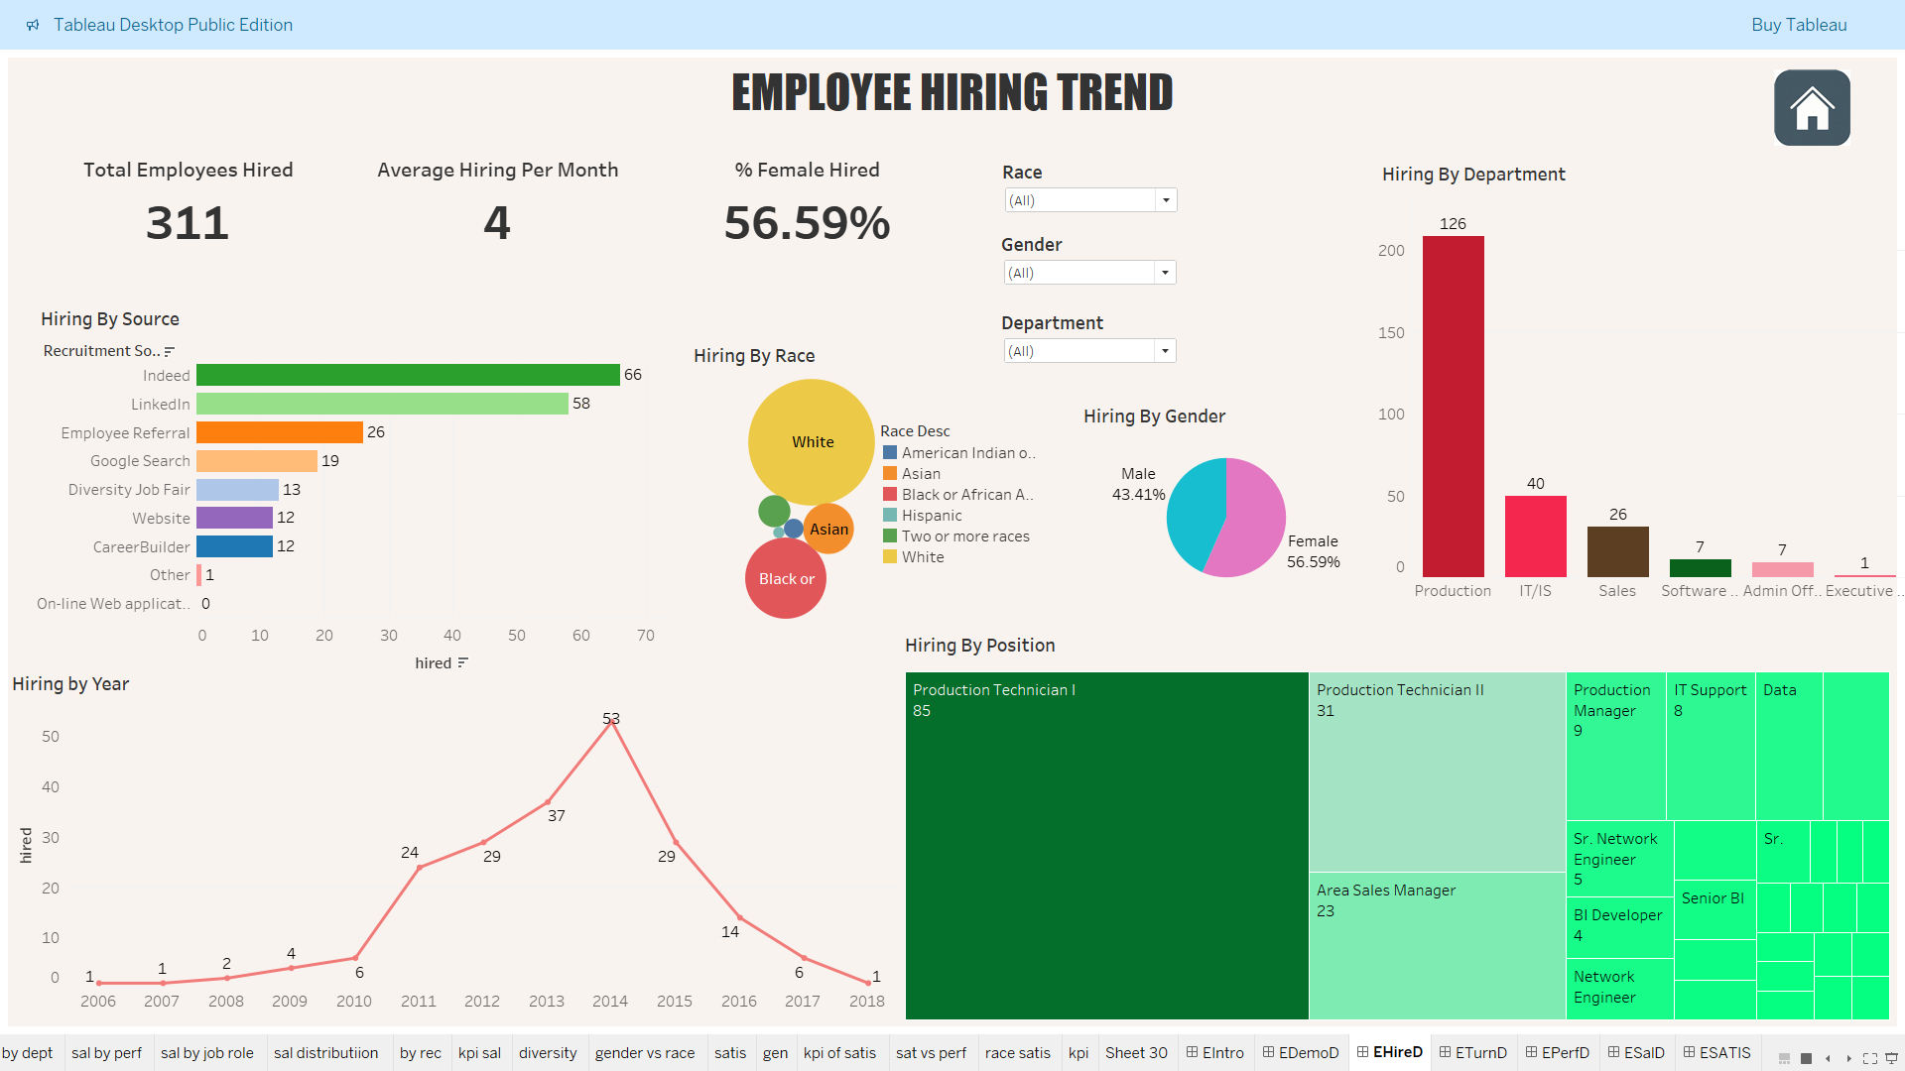

Slide 7
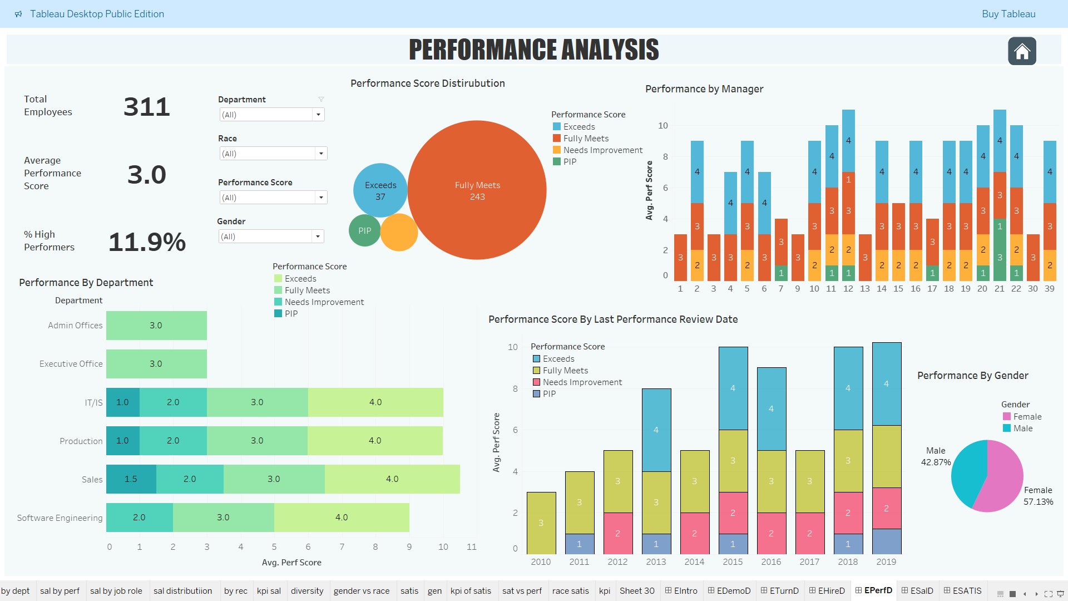

Slide 8
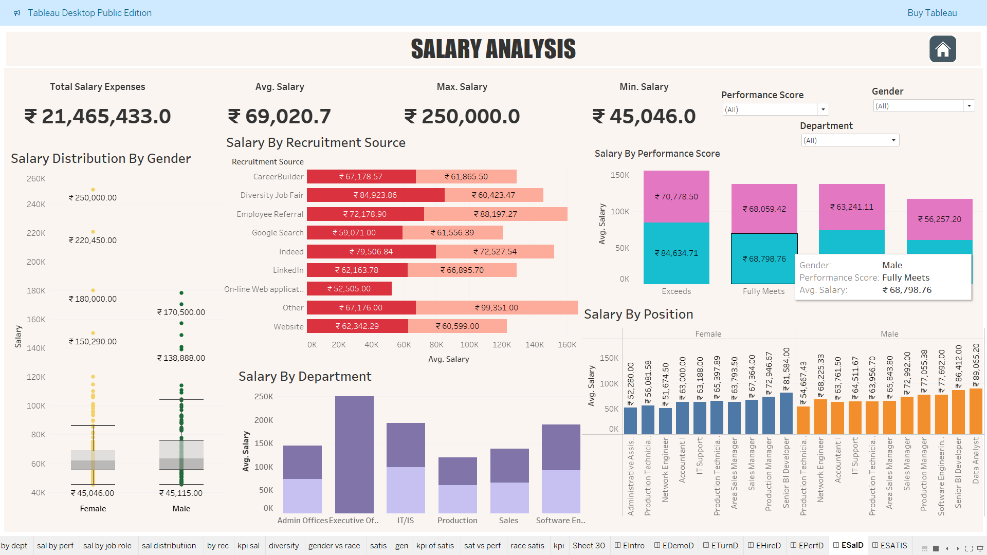

Slide 9
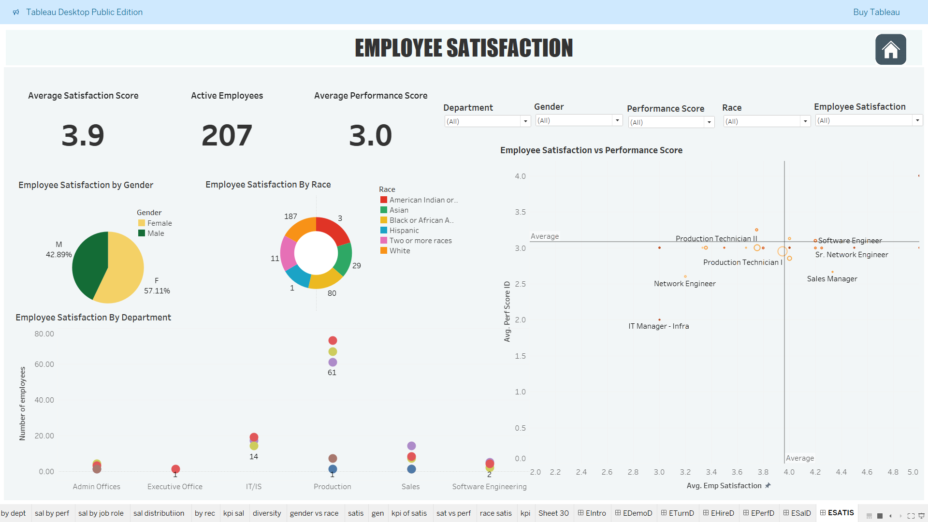

Slide 10
Employee Demographics Analysis
Total Active Employees: 207
Gender Distribution: Higher female representation (57.11%) vs. male (42.89%).
Racial Breakdown:
Majority White (187 employees).
American Indian/Alaska Native: 3 employees.
Other racial groups underrepresented.
Departmental Distribution:
Production has the highest number of employees.
Executive Office has the fewest employees.
Hiring Disparity: 124 White hires vs. only 1 Hispanic hire.
Solutions:
Promote Diversity & Inclusion: Increase hiring from underrepresented groups.
Balance Gender Representation: Encourage leadership opportunities for both genders.
Expand Recruitment Efforts: Improve outreach to attract a more diverse workforce.
Departmental Workforce Planning: Align staffing with business needs across departments.

Slide 11
Turnover Analysis
High Turnover (33.4%), led by Production (26.7%).
Peak in 2015-16 (22%, 21%), drop in 2017 (8%), rise in 2018 (12%).
Main Reasons: 20 left for another job, 14 unhappy.
Higher Female Turnover (19.2%) vs. Male (14.1%)
Solutions:
Improve retention with better pay, career growth, & training.
Address job dissatisfaction via surveys & engagement programs.
Reduce female turnover with flexible policies & leadership support.
Hiring Analysis
Avg Hiring: 4/month, decline in 2018 (only 1 hire).
Gender Bias: 59.5% hires female.
Top Hiring Sources: Indeed (66), LinkedIn (58), Web Applications = 0.
Racial Disparity: 124 White hires, only 1 Hispanic.
Solutions:
Diversify hiring outreach to underrepresented groups.
Fix the online application system for better visibility.
Balance hiring across departments.

Slide 12
Performance Analysis
Low High Performers (11.9%), most in Fully Meets (243).
Top Performers in Production (27) & IT (6).
Gaps: Sales (2 exceed, 4 PIP), Software Eng. (2 exceed, 1 PIP).
Improvement in 2019: 29 exceed vs. 1 in 2018, 0 in 2017.
57.13% of high performers are female.
Solutions:
Increase high performers via training & incentives.
Address PIP cases with coaching & development.
Improve leadership effectiveness.
Salary Analysis
Total Expenses: $21.46M | Avg Salary: $69,020.7
Pay Gap: High performers - Females ($70,778.5), Males ($84,634.71).
Lowest Salaries: Admin Asst. (F: $52,280), Prod. Tech. 1 (M: $54,667.43).
Exec Office: Highest pay ($250K), but males capped at $178K.
Solutions:
Standardize pay across roles & performance.
Increase female high-performer salaries.
Adjust low-wage roles & ensure fair executive pay.

Slide 13
Employee Satisfaction
Average Satisfaction Score: 3.9 | Average Performance Score: 3.0
Gender Satisfaction: Females (57.11%), Males (42.89%).
Demographic Trends: White Employees Average Score 2.98, American Indian/Alaska Native 3.33.
Production Satisfaction: 67 rated 4, 73 rated 3, 61 rated 5.
Solutions:
Conduct regular feedback surveys to address concerns.
Improve White employee satisfaction through engagement.
Maintain high satisfaction in Production while addressing lower scores.

Slide 14
Tableau Dashboard Link:
Human Resource Analysis
LinkedIn Link:
Nimisha Jyothi

Slide 15
Conclusion
The Tableau HR analysis reveals critical workforce trends, including high turnover rates, gender pay disparities, performance gaps, and hiring imbalances. Addressing these challenges through employee retention programs, fair compensation structures, targeted training, and improved hiring strategies will enhance workforce stability and productivity. Data-driven HR decisions will foster a more inclusive, engaged, and high-performing organization.

